Slide 1



User-Friendly-Jukebox
ENSE 885AS Activity 2 Presentation
Brandon Watson

Slide 2




Activity 1 Update
Buttons:
There will be 5 playlists (Oldie Goldies, 60’s & 70’s, Jazz/Crooners/Standards, New & Classic Country, Two-Step/Waltz/Polka Dance Party)
There will be a shuffle function that shuffles music from all playlists
The Jukebox will be expanded in the future to include some modern playlists
1

Slide 3
UN Sustainable Development Goals
Goal 12: Responsible Consumption and Production
Goal 3: Good Health & Well-being
2

Slide 4
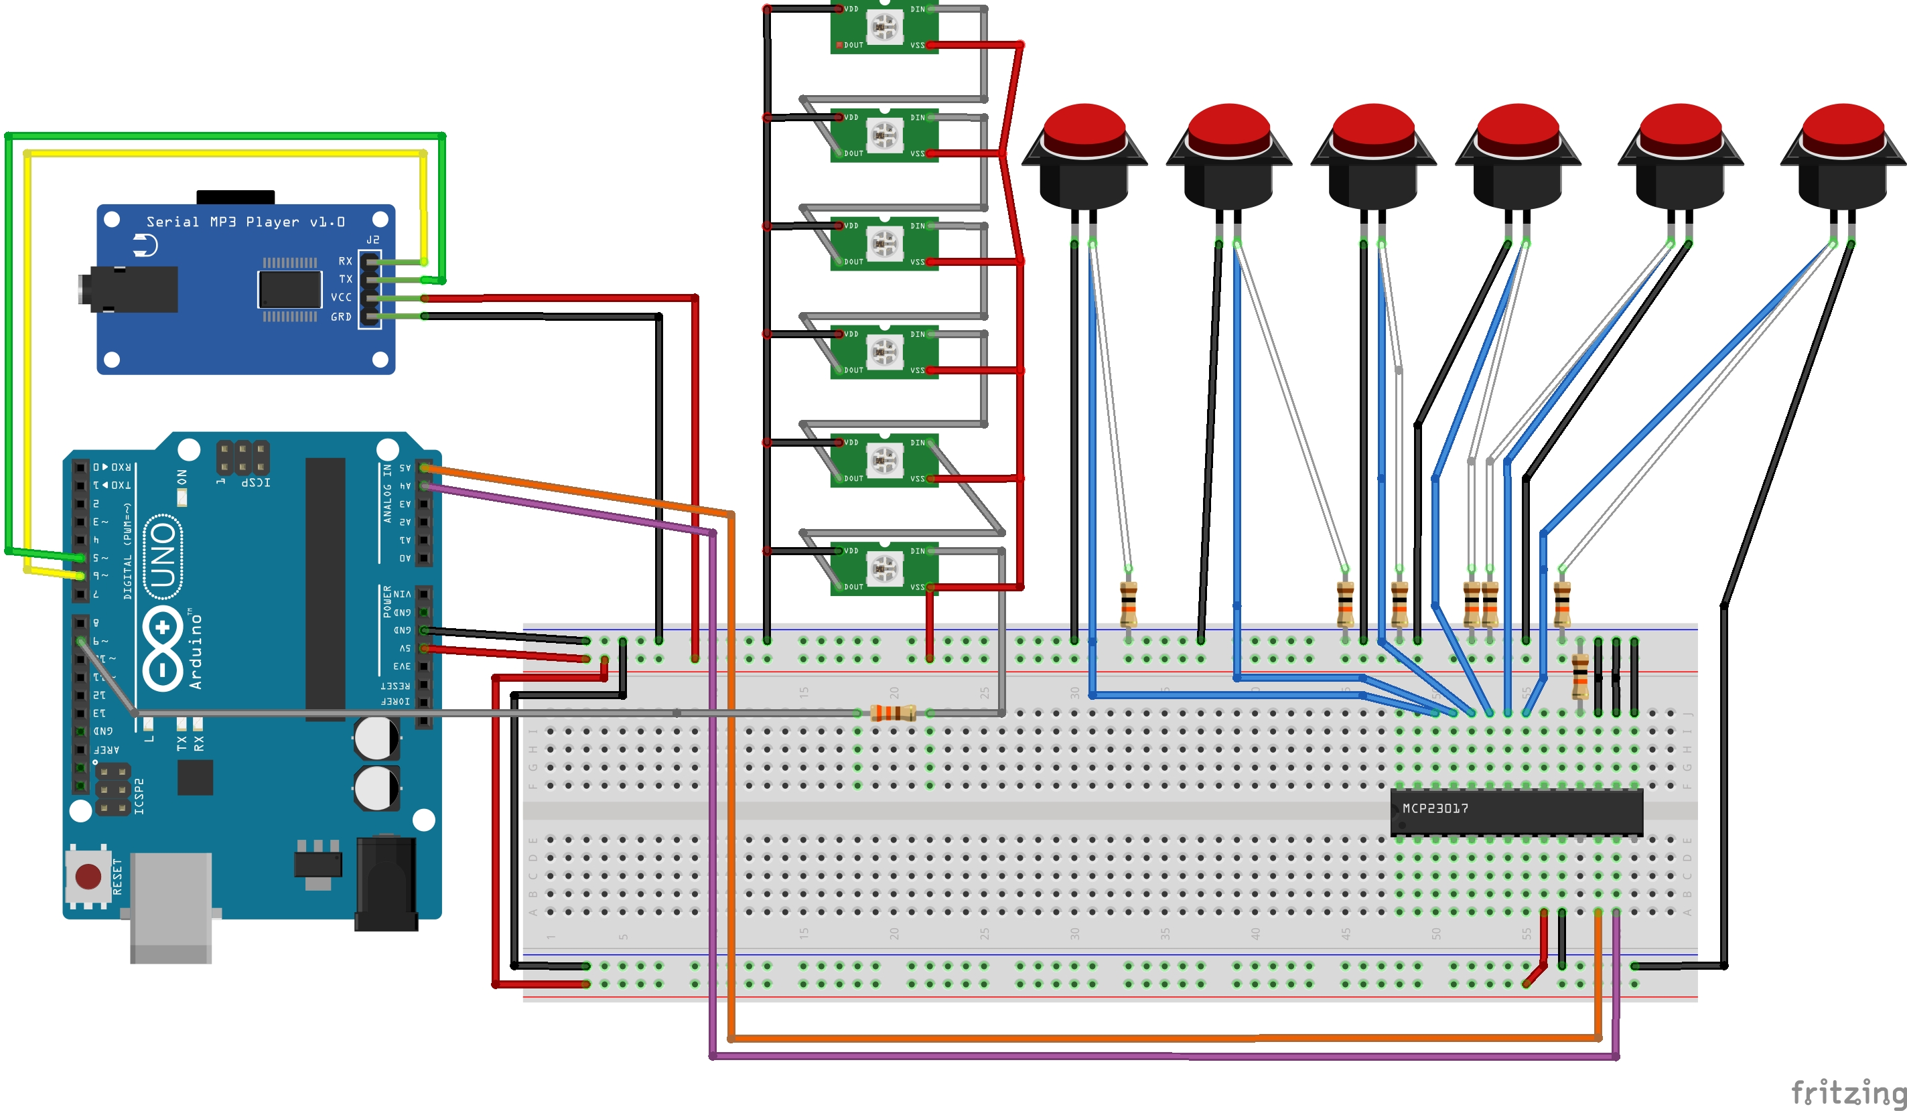
Wiring Diagram
3

Slide 5
Main Components
Arduino Uno – main control
Serial mp3 Player – storing, reading & playing mp3’s
Mcp23017 Port Expander – adding expandability (up to 16 buttons)
Momentary Buttons – to control the Jukebox
Digital RGB LED’s – indicate which playlist is currently playing
4

Slide 6
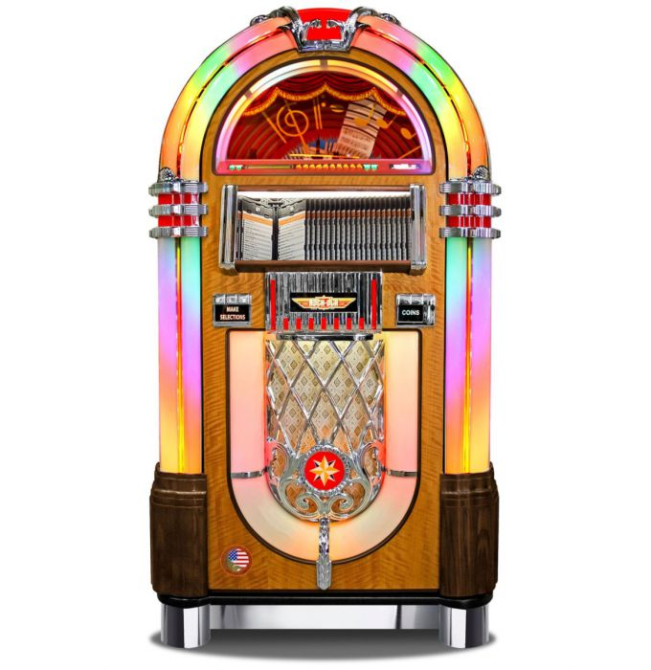
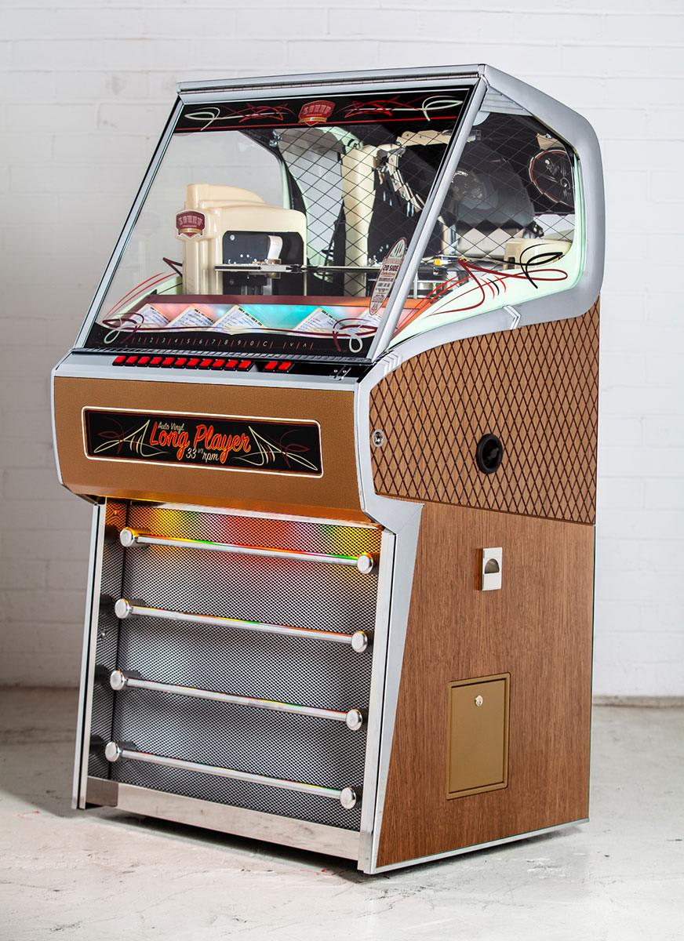
Design Inspiration
Classic jukebox designs will serve as inspiration for the design of the User-Friendly-Jukebox
5
Figure 1: Fifties Store Jukebox
Figure 2: Home Leisure Direct Jukebox

Slide 7
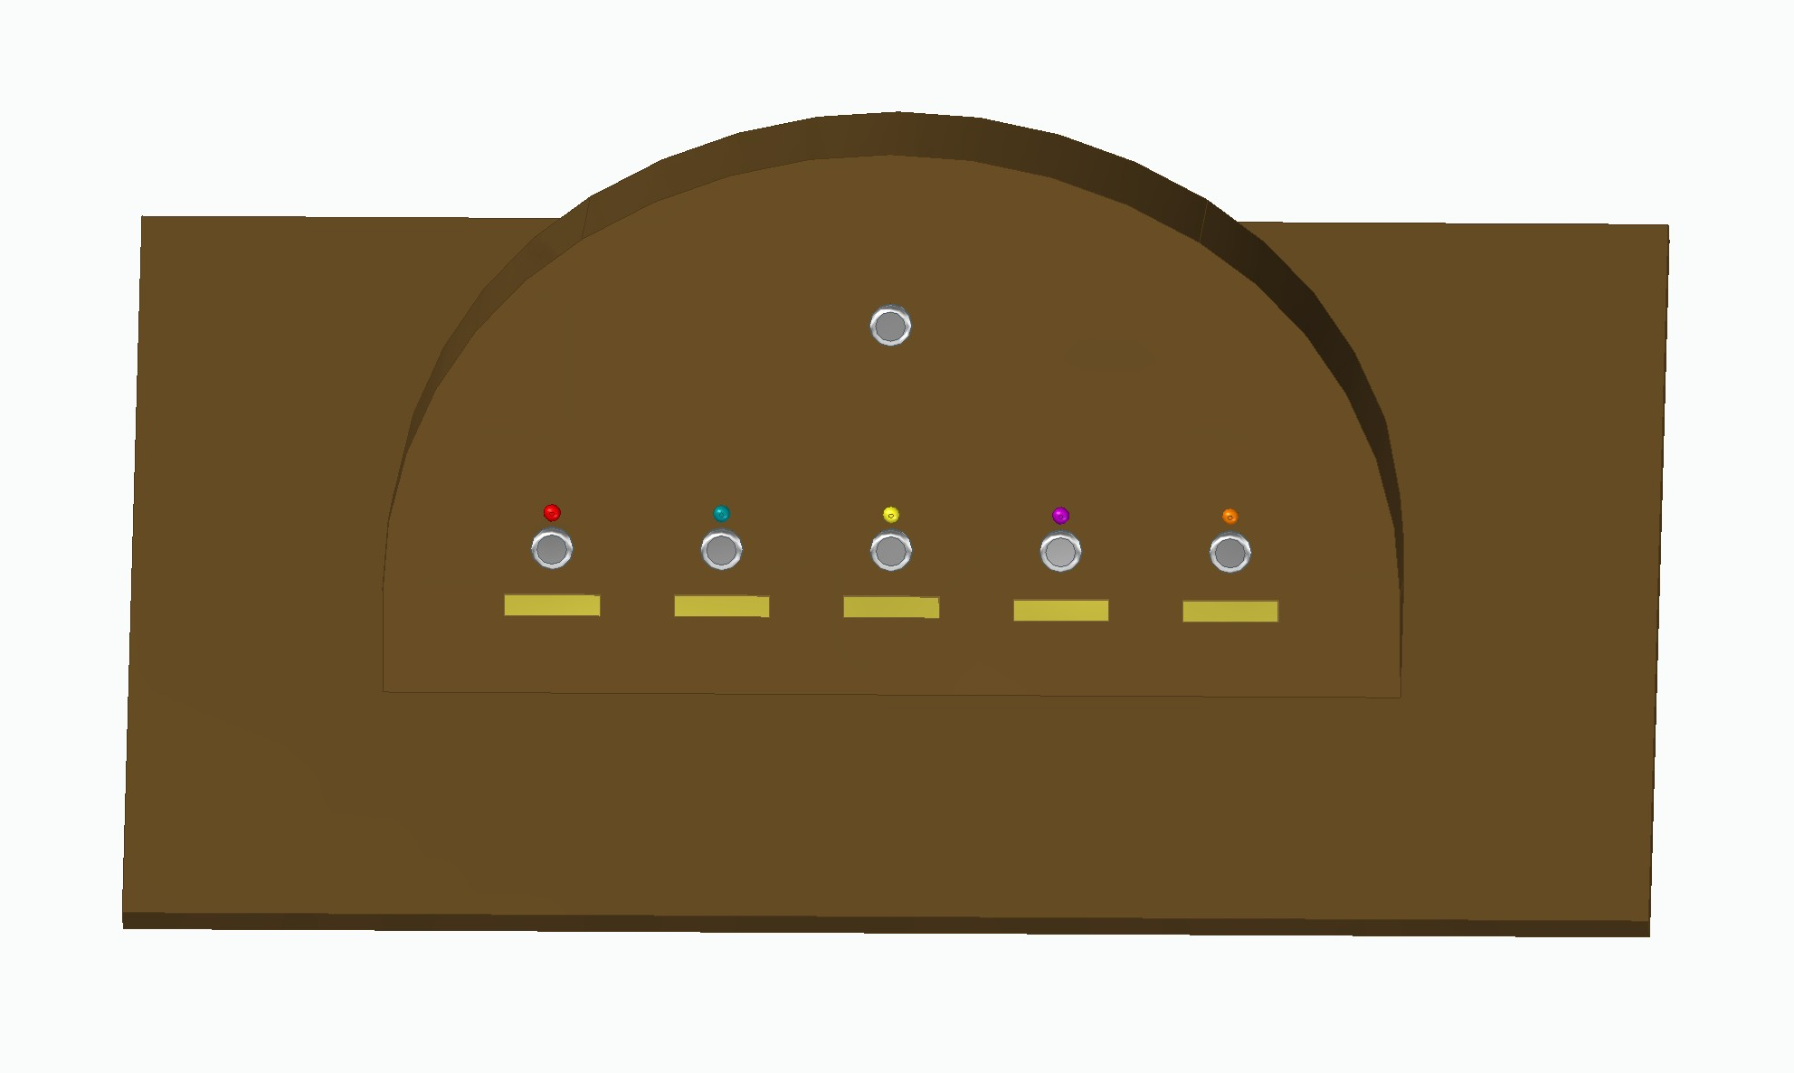

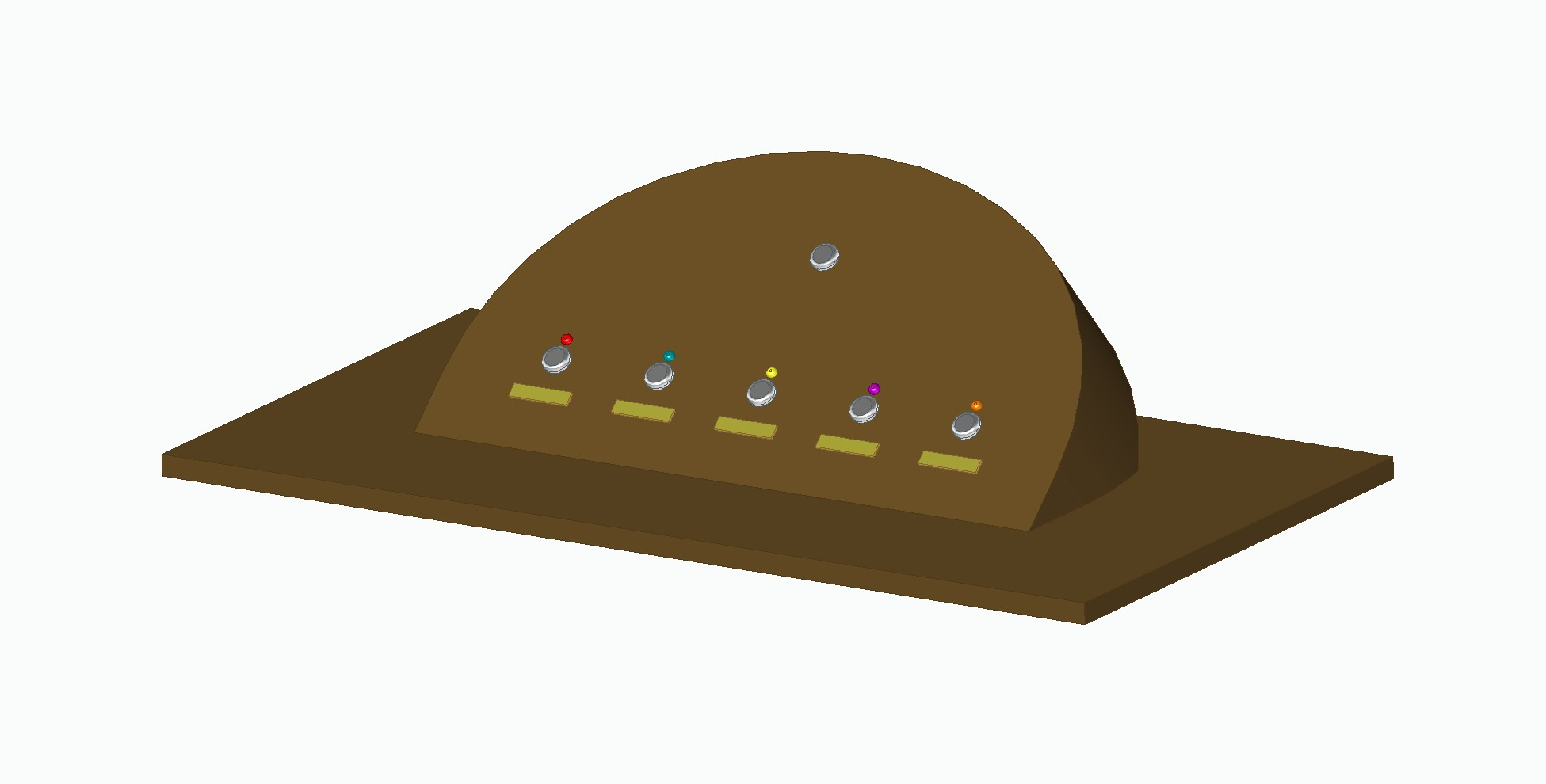
Jukebox Design
6

Slide 8
Jukebox Design
Design Elements:
Round design ques from classic jukebox designs
Angled up at a 42 degree angle for easier use when standing
Extra room for expandability in the future
Materials:
Construction: Walnut / Maple / Hickory / Cherry
Buttons: Stainless steel waterproof buttons
Playlist Name Tags: engraved metal plates
7

Slide 9
Project requirements
Functional Requirements:
Must have a footprint matching that of the existing sound system cabinet as it will be installed on top of the existing sound system cabinet.
Must be easy to use.
Must have a series of buttons with corresponding labels and lights to indicate whether they are active or not.
Must allow access to the internal MP3 player so that music changes can be made.
Must be planned with expandability options allowing for additional music genre buttons in the future.
Technical/Performance Requirements:
Must be stable/dependable/reliable
Must connect to the existing sound system with a 3.5mm AUX cable
8

Slide 10
Works Cited
Fifties Store. “Rock-Ola 1015 Bubbler CD Jukebox - Classic Walnut.” Fifties Store, 24 May 2021, www.fiftiesstore.com/jukebox-rock-ola-1015-cd-bubbler.html.
Home Leisure Direct. “Sound Leisure Anniversary Long Player Jukebox.” Home Leisure Direct, www.homeleisuredirect.com/jukeboxes/sound-leisure-jukeboxes/sound-leisure-anniversary-long-player-jukebox.html.
9

